Slide 1
Comparative Study of Cloud Computing Service Models
CLOUD COMPUTING
(SE-414)
MTE PROJECT
By : Aman Bhatia 2K18/SE/019
Ashish Kumar 2K18/SE/041
Submitted To:
Ms. Sonali Chawla

Slide 2
Table of Contents
Abstract
Introduction
Cloud Computing Models
Results and Findings
Conclusion
References

Slide 3
ABSTRACT
Cloud computing has many security flaws which need to look upon by the researchers so that it can gain trust by the users. In this paper, we'll look at three cloud computing service models: software as a service (SaaS), platform as a service (PaaS), and infrastructure as a service (IaaS). This research will focus on the security issues associated with each model, their benefits, and a comparative study will be conducted between them to evaluate their capabilities so that selecting the best one for the R&D phase will be straightforward and simple.
The motivation behind this research is to provide the beginner with in-depth information about these Cloud Computing Service Models and after that they can decide which is appropriate for them at right place.

Slide 4
2.
Introduction

Slide 5
Cloud computing is a method of distributing hardware and software resources such as software applications, CPU, and storage to consumers and provides service over the internet. Cloud computing is a rapidly growing field that corporate IT companies to go ahead of old IT infrastructures and they start relying on web-based services. Cloud computing is offered in three different service models and they are:
Software as a service (SaaS),
Platform as a service (PaaS) and
Infrastructure as a service (IaaS)

Slide 6
3. Cloud Computing
Models
Software as a service (SaaS),
Platform as a service (PaaS) and
Infrastructure as a service (IaaS)

Slide 7
Software as a Service(SaaS)
It is a model which allow the clients to use and rent the applications from the provider without install it on their own PC. This means that the licensed applications which been provided to clients are running on cloud infrastructure through the interface of thin/thick client such as Google chrome, internet explorer and many others.
The management and control of the infrastructure will be under the provider responsibility, only limit number of customers would have their own configurations
SaaS model is classified as a best way to get the lightweight applications such as Microsoft word, Microsoft access, media player and so on.
Advantages:
Access app data from anywhere: With data stored in the cloud, users can access their information from any Internet-connected computer or mobile device.
Reduce distribution and maintenance costs and minimal end-user contribution generally makes SaaS application easy to use.
SaaS supports multiple users that means one application could be run by many other clients at the same time.
SaaS applications has these features: automated upgrades and updates, patch management and faster rollout of changes.
Secure socket layer (SSL) used in SaaS model.
Security issues:
Security of data
Locality of data
Data Privacy
Integrity of Data
Accessibility of Data
Sniffing of data on the network
Authentication, Authorization
Web Application Security
Availability
Backup

Slide 8
Platform as a Service(PaaS)
It an environment or platform in which the developer can develop the applications and software to deploy them through the internet without any need for install or manage the development environment.
PaaS allows the customer to rent virtualized servers and attached services.
The customer has no control over servers, networks, storage or OS.
However, the customer has the control over the deployed applications and their configurations.
Advantages:
Increase the flexibility for the development process and decrease the server storage overhead.
The security is provided, containing data security, recovery and backup.
Reduce the cost by rent the physical and removing the need of expert people to manage the infrastructure.
Adaptability, that mean it has the ability to change if the circumstances are altered.
PaaS is working on basis of one-to-many; so many developers can work on same application.
Flexibility: Developers can customize apps without the headache of maintaining the software.
Security issues:
Third party relationships
Rapid change of application
Security of underlying Infrastructure

Slide 9
Infrastructure as a Service(IaaS)
It provides virtual infrastructure with raw hardware, as well as the ability to create, manage, remove storage & virtual machines (VMs) through web-based service. IaaS delivers cloud computing infrastructure, including servers, network, operating systems, and storage, through virtualization technology.
The IaaS provider provides the customer with a virtual server and one or more CPUs that run a variety of operations.
In order to service the client, the provider is responsible for operating, hosting, and maintaining the infrastructure.
The client has control over the IP address, CPU, Memory, Storage, installed apps, OS, and a limited number of networking components.
Advantages:
The client has the ability to scale up or down the infrastructure as needed.
The client is able to run a virtual computer as a result of Virtualization service.
Easy to automate deployment of storage, networking, servers, and processing power.
Network as a service is offered, which comprises of load balancing, router and firewall technology.
Lowering the cost of HR and equipment.
Security issues:
Virtualization Attacks.
Shared resource Vulnerability.
Malicious Code.
Data Loss and Leakage.

Slide 10

4. RESULTS AND FINDINGS

Slide 11
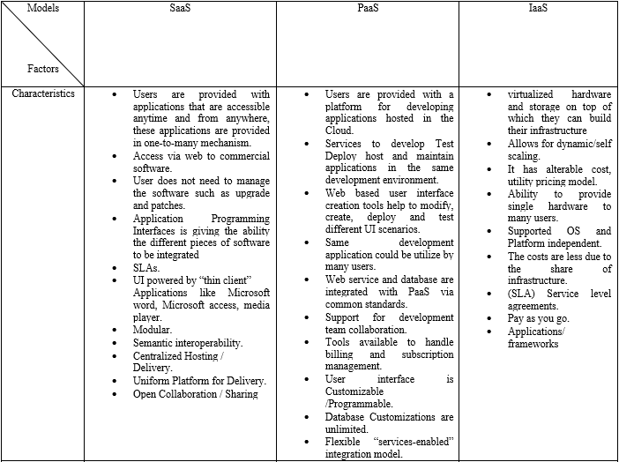
RESULTS AND FINDINGS

Slide 12
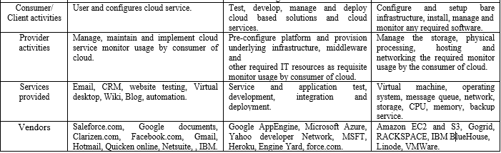
TABLE 1: COMPARISON TABLE AMONG THE THREE MODELS OF CLOUD SERVICES SAAS, PAAS AND IAAS

Slide 13
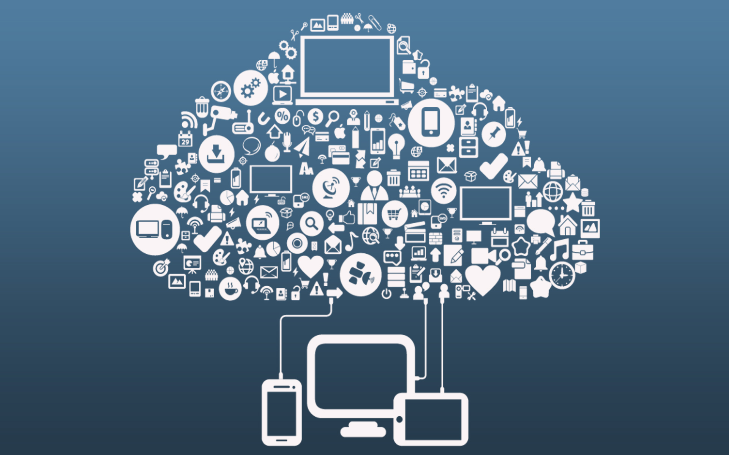
5. Conclusion

Slide 14
Conclusion
We looked at the three cloud computing service models in this study i.e. SaaS, PaaS, IaaS. This paper focused on the security concerns of each model, as well as the benefits connected with them, and a comparison study was conducted among them.
This comparative analysis aided cloud clients in determining what kind of service features they require, as well as the types of risks associated with each model. Despite the numerous benefits associated with each model, each model also has a number of security, service level agreement, and privacy challenges that discourage users from moving their own work to cloud computing.

Slide 15

6. REFERENCE

Slide 16
Reference
[1]. Hashizume, K., Rosado, D.G., Fernández-Medina, E. et al. “An analysis of security issues for cloud computing”. Journal of Internet Services and Applications (2013). https://doi.org/10.1186/1869-0238-4-5.
[2]. “The three service models of Cloud Computing | OPEN.” [Online]. Available: https://www.openintl.com/the-three-service-models-of- cloud-computing/ (accessed Apr. 02, 2022).
[3]. Zaigham Mahmood, “Cloud Computing: Characteristics and deployment approaches,” Proc. - 11th IEEE Int. Conf. Comput. Inf. Technol. CIT, pp. 121–126, 2011.
[4]. D. Rani and M. T. C. S. E. Student, “A Comparative Study of SaaS , PaaS and IaaS in Cloud Computing,” vol. 4, no. 6, pp. 458– 461, 2014.
[5]. ON, T. F. Cyber Security and Reliability in a Digital Cloud. 2013.
[6]. A. M. MayankaKatyal, “A Comparative Study of Load Balancing Algorithms in Cloud Computing Environment,” Int. J. Distrib. Cloud Computing, vol. 1, no. 2, p. 14, 2013.
[7]. O. P. Karada, A. Pipliya, P. Thakur, and N. Kamdar, “Analytical Survey Model on Consumption of Cloud Service Models,” pp. 46–50, 2011.
[8]. C. N. Höfer and G. Karagiannis, “Cloud computing services: Taxonomy and comparison,” J. Internet Serv. Appl., vol. 2, no. 2, pp. 81–94, 2011.

Slide 17
Reference
[9]. Kavis, M. J. Architecting the cloud: Design decisions for cloud computing service models (SaaS, PaaS, AND IaaS). John Wiley & Sons. 2014.
[10]. G. Kulkarni, P. Chavan, H. Bankar, K. Koli, and V. Waykule, “A New Approach to Software as Service Cloud,” 2012 7th Int. Conf. Telecommun. Syst. Serv. Appl., pp. 196–199, 2012.
[11]. L. Tim Mather, SubraKumaraswamy, “Cloud Privacy and Security,” Gov. An Int. J. Policy Adm., p. 336, 2009.
[12]. M. Computing, D. Thakral, and M. Singh, “Virtualization in cloud computing 1,” vol. 3, no. 5, pp. 1262–1273, 2014.
[13]. R. Article, “SECURITY CHALLENGES IN DIFFERENT DELIVERY MODEL SPECIFICALLY SaaS,” 2015.
[14].Yu, Shucheng, Wenjing Lou, and KuiRen. "Data Security in Cloud." Handbook on Securing Cyber-Physical Critical Infrastructure (2012): 389.
[15]. G. Kalpana, P. V Kumar, and R. V Krishnaiah, “A brief Survey on Security Issues in Cloud and its service models,” vol. 4, no. 6, pp. 457–463, 2015.

Slide 18
Reference
[16]. Inamul Haq, Muhammad. "The major security challenges to cloud computing." (2013).
[17]. Bhadoria, Robin Singh. "Security Architecture for Cloud Computing." Handbook of Research on Securing Cloud-Based Databases with Biometric Applications (2014): 47.
[18]. J. Gibson, R. Rondeau, D. Eveleigh, and T. Qing, “Benefits and challenges of three cloud computing service models,” Comput. Asp. Soc. Networks, pp. 198–205, 2012.
[19]. S. Khurana and A. G. Verma, “Comparison of Cloud Computing Service Models : SaaS ,PaaS , IaaS,” Int. J. Electron. Commun. Technol., vol. 7109, pp. 29–32, 2013.
[20]. Subashini, Subashini, and V. Kavitha. "A survey on security issues in service delivery models of cloud computing." Journal of network and computer applications 34.1 (2011): 1-11.
[21]. Felter, Wes, et al. "An updated performance comparison of virtual machines and linux containers." technology 28 (2014): 32.
[22]. Fernandez, Eduardo B., Raul Monge, and Keiko Hashizume. "Building a security reference architecture for cloud systems." Requirements Engineering(2015): 1-25.
[23]. Moreno-Vozmediano, Rafael, Rubén S. Montero, and Ignacio M. Llorente. "IaaS cloud architecture: From virtualized datacenters to federated cloud infrastructures." Computer 12 (2012): 65-72.

Slide 19
THANK YOU

